Slide 1
English 9 Literary Terms

Slide 2
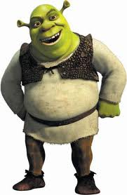
Character
A person portrayed in a literary work
Main Character (Shrek)– central to the story; fully developed
Minor Character (Donkey) – has few personality traits; helps move the story
Round Characters (Fiona)– show varied and sometimes contradictory traits
Flat Characters (Soldiers) – only show one personality trait
Dynamic Characters (Shrek)– grow and change throughout the story
Static Characters (Pinocchio)– stay the same

Slide 3
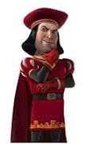
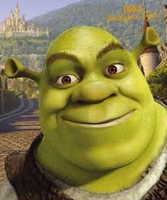
Character
Protagonist - the main character in a story, novel, drama, or other literary work; the character that the reader or audience empathizes with
Antagonist – the character who strives against the main character

Slide 4
Plot
The sequence of events in a short story, novel, or drama
Climax
Falling Action
Resolution
Rising Action
Exposition

Slide 5
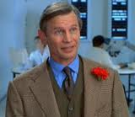
Exposition
Provides info on plot, background, setting, and characters
Ex. Basil Exposition from Austin Powers

Slide 6
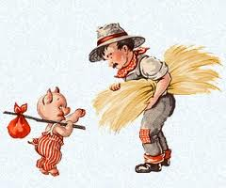
Rising Action
Introduces related secondary conflicts and various obstacles that keep the protagonist from reaching his/her/its goal

Slide 7
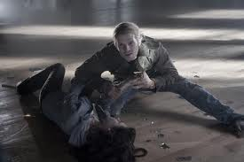
Climax
The point of greatest intensity or force
Dance studio scene in Twilight

Slide 8
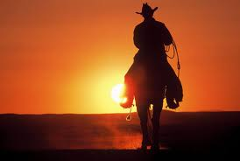
Falling Action and Resolution
The part of the story where the conflict unravels, and you are headed towards the conclusion

Slide 9
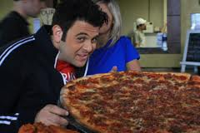
Conflict
3 types of conflict
Man vs. Man
Man vs. Nature
Man vs. Himself

Slide 10
Point of View
The standpoint from which a story is told
First Person – the narrator is a character in the story and uses “I”, “we”, “me”, etc.
Second Person – the narrator is someone who stands outside the story and describes the characters and action; uses the pronouns “you” and “your”
Third Person Omniscient – the narrator is all-knowing; uses the pronouns “he”, “she”, “they”, etc.
Third Person Limited – the narrator describes events as only one character perceives them; uses the pronouns “he”, “she”, “they”, etc.

Slide 11
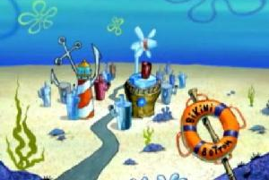
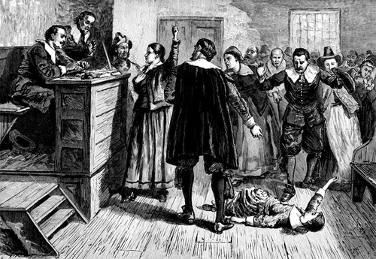
Setting
The time and place in which the events of a literary work occur
Includes the ideas, customs, and beliefs of a particular time and place
The setting of The Crucible is 1692 in Salem, Massachusetts.
The setting of Spongebob Squarepants is present day Bikini Bottom.

Slide 12
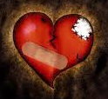
Theme
The central message of a work of literature, often expressed as a general statement about life
Themes are topics on steroids
Example:
Topic: Love
Theme: Love is painful

Slide 13
Foreshadowing
Foreshadowing is the use of clues to hint at what is going to happen later in the plot.
Arouses the reader’s curiosity and builds suspense
Example:
Montresor drinks to Fortunato’s health in “The Cask of Amontillado”.

Slide 14
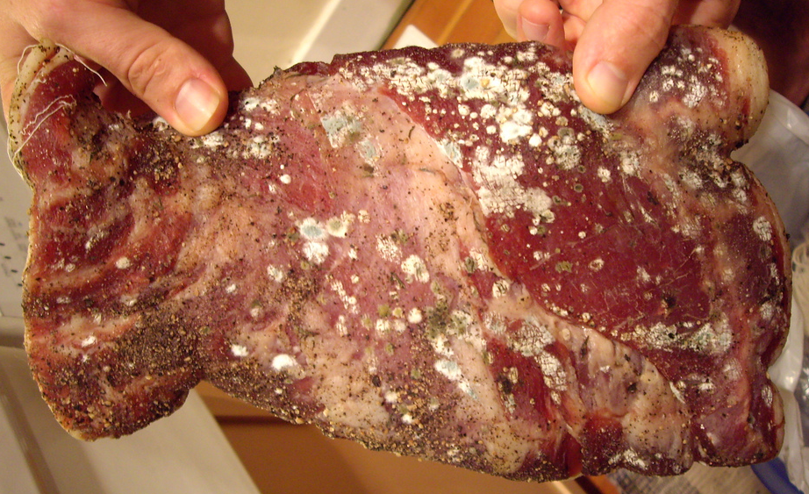
Metaphor
A figure of speech that is an implied comparison between seemingly unlike things
Example:
Their love was sickening. She was a colony of E.coli growing on him, the room temperature Canadian beef.

Slide 15
Simile
A figure of speech that makes comparisons using the words “like,” “as,” or “than.”

Slide 16
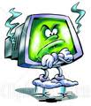
Personification
A figure of speech in which an animal, an object, a force of nature, or an idea is given human characteristics
Example:
Computers hate me.

Slide 17
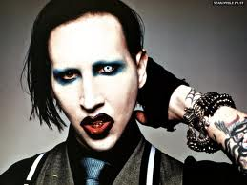
Hyperbole
A figure of speech that uses exaggeration to express strong emotion, to make a point, or to evoke humor
Example:
My aunt uses so much makeup, Marilyn Manson freaked out when he saw her.

